Slide 1

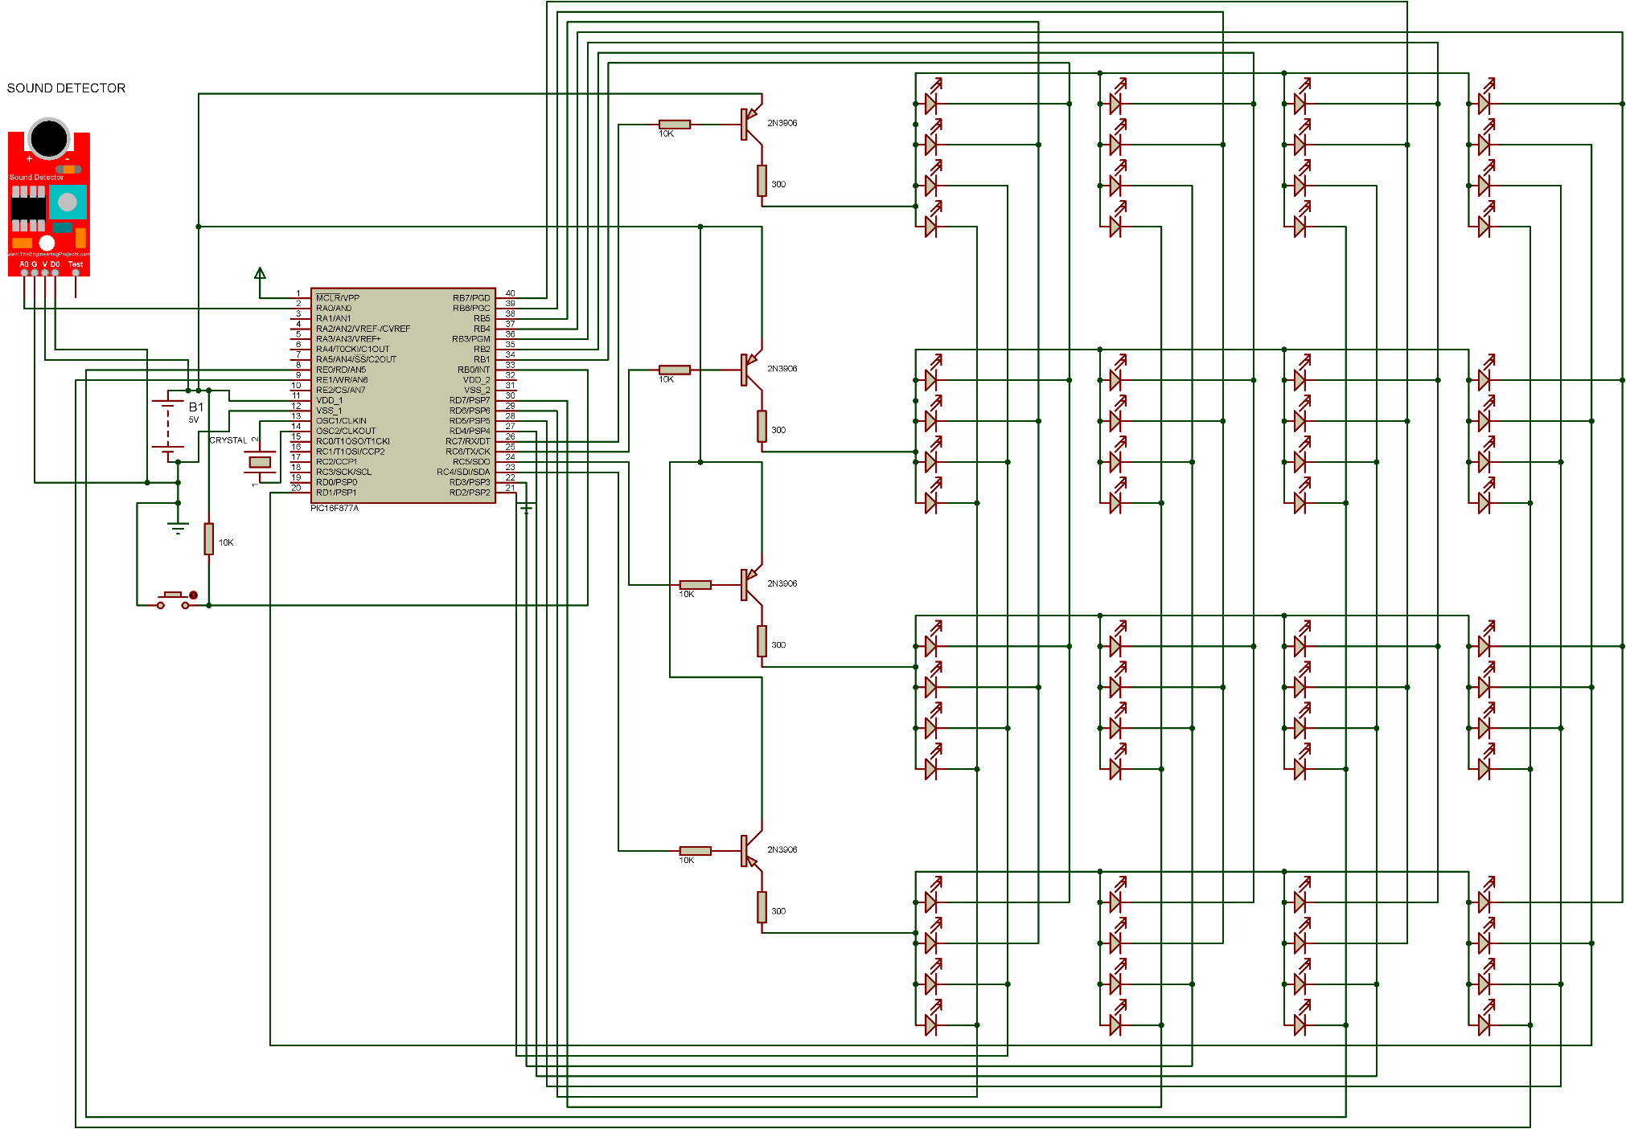
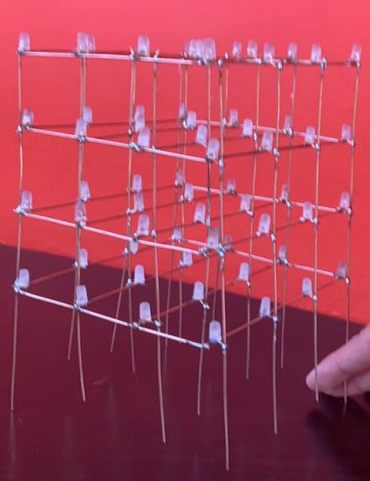
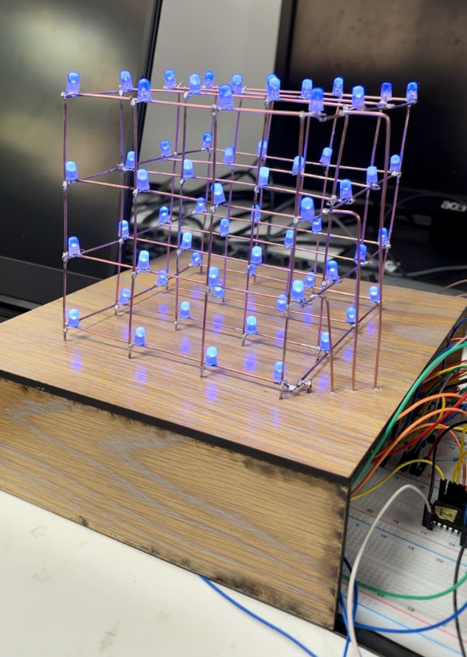
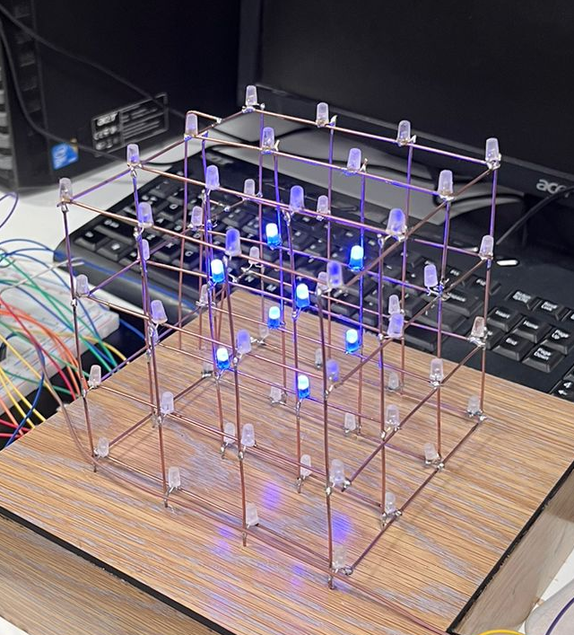
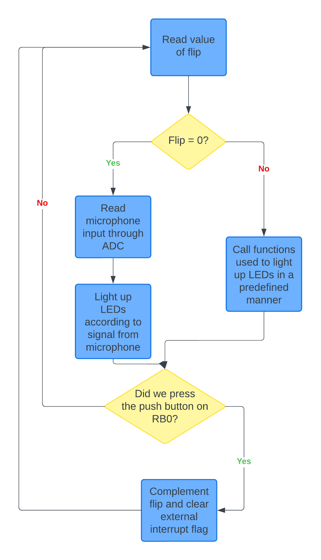
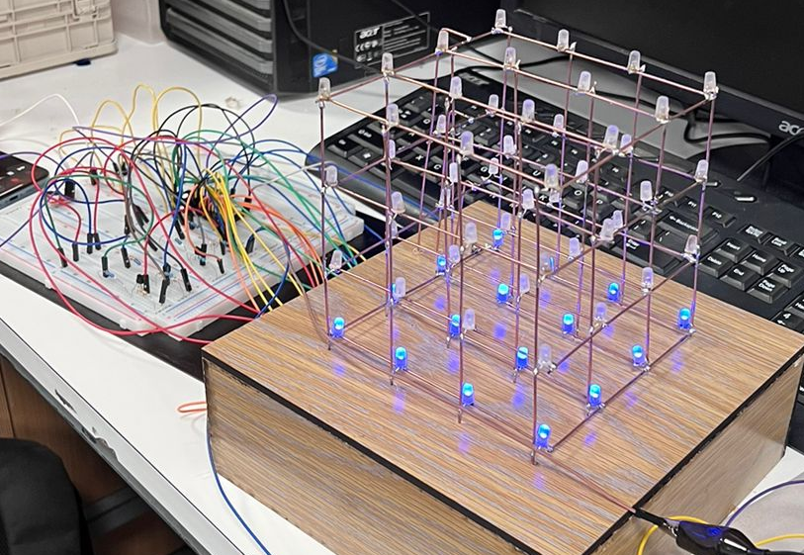
4x4x4 LED Cube
T. Hasan, Y. Jizawi and M. Tarifi
Supervisor: Dr. Belal Sababha
Embedded Systems Final Design Project, Spring 2023
King Abdullah II School of Engineering
Princess Sumaya University for Technology
Introduction
Our project is a music reactive LED cube that consists of a Microphone that is responsible for changing the manner in which the LED cube lights up.
Using 64 LEDs and PIC16F877A we brought it to life. Our LED cube has two main modes. The first mode makes the cube light up in certain animations by calling functions that implement the use of timer0 delays. The second mode interfaces the microphone by using the on-chip Analog-to-Digital converter, then the digital input is used to make the cube light up in a way similar to speaker.
Figure 4: Cube Schematic.
Results
After connecting everything in its place, the cube is functioning correctly and as needed. When you are in the standby mode, the cube lights up in different animations using the embedded functions mentioned before. The figure below shows a picture of the cube in one of our animations in the standby mode.
Figure 5: A movement from the standby mode.
When switching to the microphone mode, the cube changes its lighting using the sound waves it detects. The movement in Figure 6 showcases how the cube lights up when the output of the ADC is between 500 - 550 (max reading = 1023). If the reading is less than 500 then the cube turns off, if the reading is greater than 550 then the level above it will turn on and so on.
Figure 6: A movement from the microphone mode.
Design
The outer shape of the cube was made of copper wires of thickness of 1.1 mm to be strong enough to handle some load and not break. Then it was placed on a wooden base to prevent it from moving. The figures below show the actual design of the prototype. The vertical bars are the cathodes (negative) of the LEDs, and the horizontal bars the anodes (positive).
Figure 1: Cube without the base. Figure 2: Cube with the base.
The schematic in figure 4 illustrates how the Cube was connected with the microcontroller. The flowchart in figure 3 show cases the concept of our software design.
Figure 3: Software design Flowchart.
Conclusion
In conclusion, the development and implementation of a 4x4x4 LED cube interfaced with a PIC16F877A microcontroller has proven to be a fascinating and rewarding project in the field of embedded systems. The LED cube serves as a visually appealing and interactive display, capable of showcasing various patterns and animations.
Throughout this project, we gained valuable hands-on experience in designing hardware circuits, programing microcontrollers, and integrating different components to create a functional system. By using the power and versatility of the PIC16F877A microcontroller, we were able to control the LEDs with precision and flexibility.

